Slide 1
BIOMED PLTW: PBS + HBS
Overview of Principles of Biomedical Science and Human Body Systems classes (from PLTW)
2018-2019
Notes:
NOTE:
To change the image on this slide, select the picture and delete it. Then click the Pictures icon in the placeholder to insert your own image.

Slide 2
Features of CCHS BioMed class
PLTW track – earn credits in colleges
AZ CTE EOCA – pass AZ CTE
Certification – OSHA and/or BACE
Innovation Fair – Inventing techniques
CTSO – HOSA ++
Advisory Board – Support group for career advancement
Dual Enrollment – more college credit

Slide 3
PLTW curriculum
PBS and HBS and more(?)

Slide 4
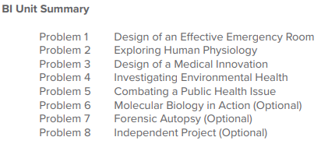
PLTW content
PBS
Principles of Biomedical Science
Forensics mystery class
Diabetes, Sickle Cell Anemia
Heart Disease, Infectious Disease
HBS
Human Body Systems
Medical mystery class
Identity, communication, and power
MI
Medical Interventions
(not available)
BI
Biomedical Innovation
(not available)
Movement, protection, and homeostasis

Slide 5
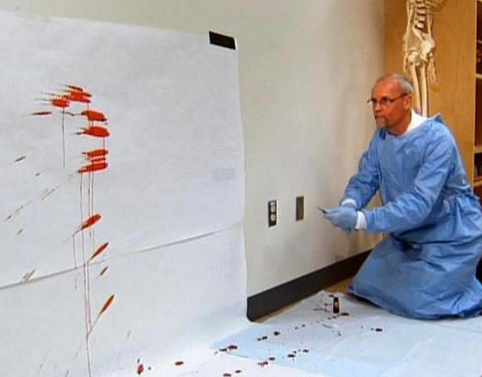
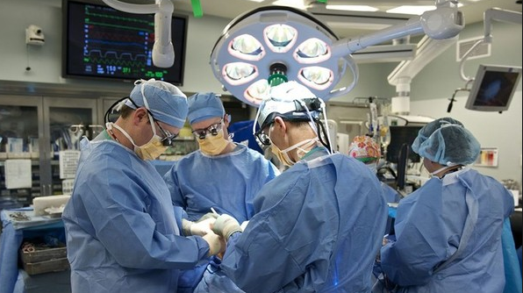
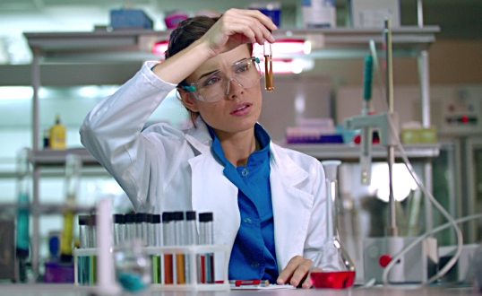
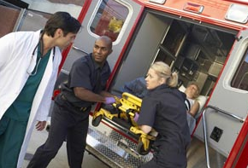
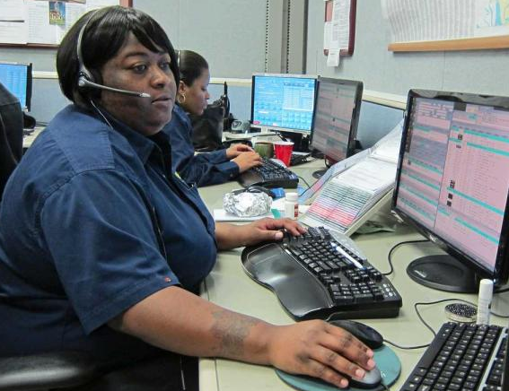
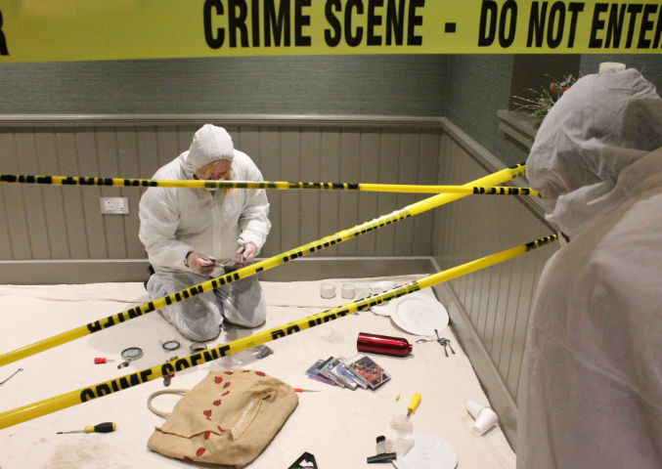

Slide 6
AZ CTE EOCA
Required testing

Slide 7
AZ CTE EOCA
= End of Course Assessment
Helps determine success of the program
Possibly help program expansion

Slide 8
Certification
Industry skills and milestones

Slide 9
Certification
This is optional
It is meant to help students get a leg up in being competitive in industry
Fees paid by…
Student/family
Possibly other sources
May require additional time
Conferences
Modified/adjusted curriculum
CTSO (not HOSA)
 |  | OSHA | BACE
Cost |  | $30 | $150
Class offered |  | PBS + HBS | HBS
Difficulty |  | Medium | Hard
Skill type |  | General lab handling | Lab tech

Slide 10
Innovation Fair
Creativity and invention

Slide 11
Innovation Fair
= HISEF (super science fair)
A fair for Chandler district
In February
Science fair
Demonstrations of CTE classes
Competition for CTE/Science clubs
Class project
Research and science report

Slide 12
CTSO
HOSA (and more?)

Slide 13
CTSO
= HOSA
Club to support the class
Provides practice time
Opportunities to compete and earn achievements
Networking
Other things that class cannot fit in
Speakers
Field trips
Activities
Certifications

Slide 14
Advisory Board
Support and career

Slide 15
Advisory Board
= Booster/rotary/PTO/etc
Community support group
Professionals
Parents
Professors
Teachers
Students
Topics
Fundraising
Volunteering and internship opportunities
Scholarship/other awards

Slide 16
Dual Enrollment
More college credit!

Slide 17
Dual Enrollment
= or just college credit
Sources
PLTW test
PLTW course completion (+ qualifying grade)

Slide 18
CCHS Class
Norms, grades, and expectations

Slide 19
Title and Content Layout with SmartArt
Grades
PLTW Deliverables
Additional projects
Lab practicals
Tests
Work
Classwork
Presentations
EOCA, tests, certification
Career
Career journal
Internship research
Projects
Final presentation (mock trial)
Lab project (Innovation Fair)
Volunteering, science fair
Field trips
Speakers/visits
Career choice

